Slide 1

Base SAS

Slide 2

Disclaimer / Audience
The purpose of this course is to cover the SAS Programming concepts for analyzing and managing data efficiently by using SAS Base.
Basic knowledge of computer is required.
Base SAS is for new SAS users who wants to apply the Data Management skills to their data and to prepare for Base SAS certification exam.

Slide 3
Why SAS?
An organization is collecting and maintaining the large amount of data for their decision making process, business growth by analyzing hidden facts and trends
Data is an information on different aspects of business which we need to analyze and manage
For rapid growth of data, the main challenge is to managing and analyzing the large data efficiently

Slide 4

Base SAS DEMO

Slide 5
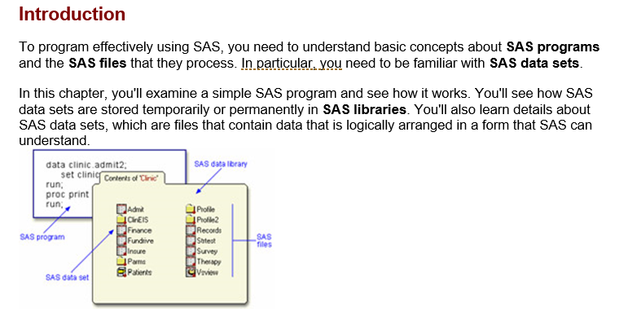
Introduction

Slide 6
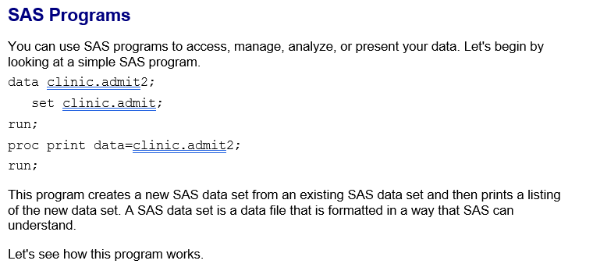
Introduction

Slide 7
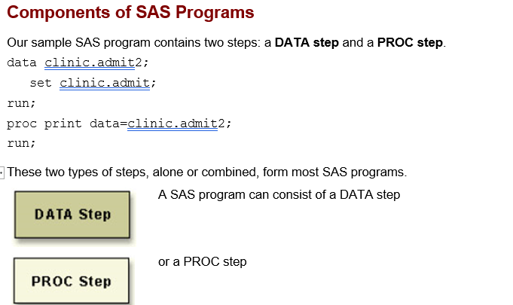
Introduction

Slide 8
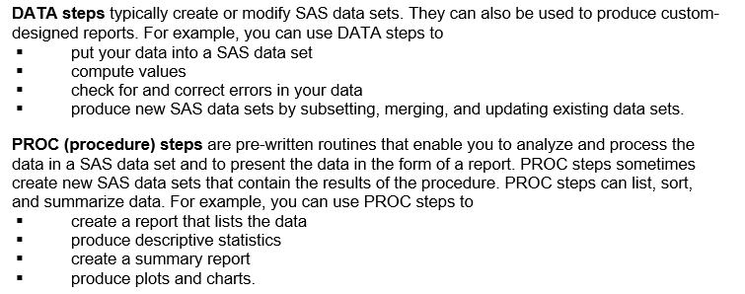
Introduction

Slide 9
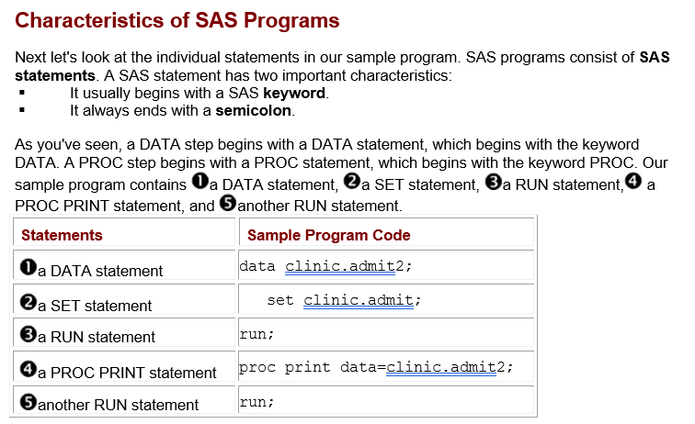
Introduction

Slide 10
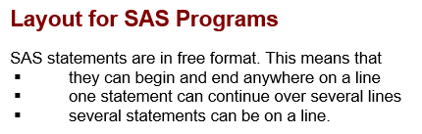
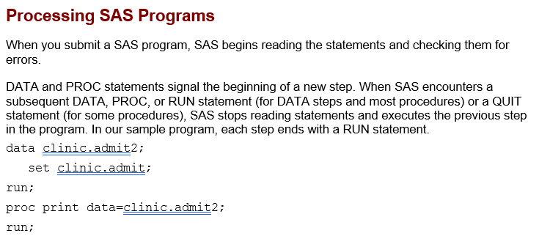
Introduction

Slide 11
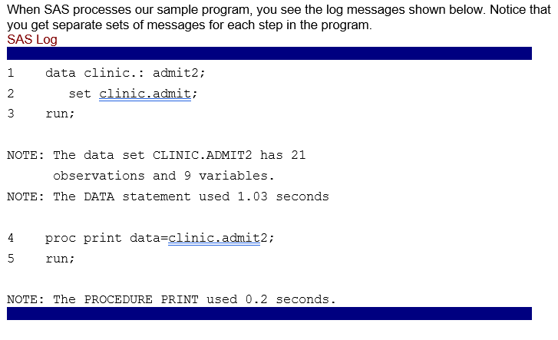
Introduction

Slide 12
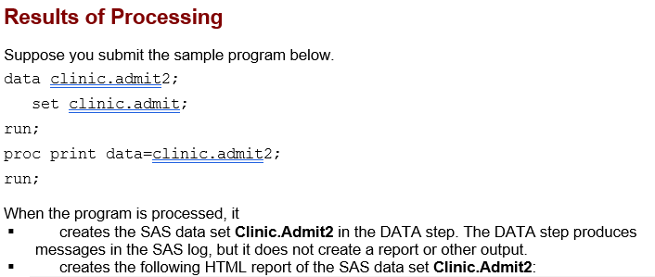
Introduction

Slide 13
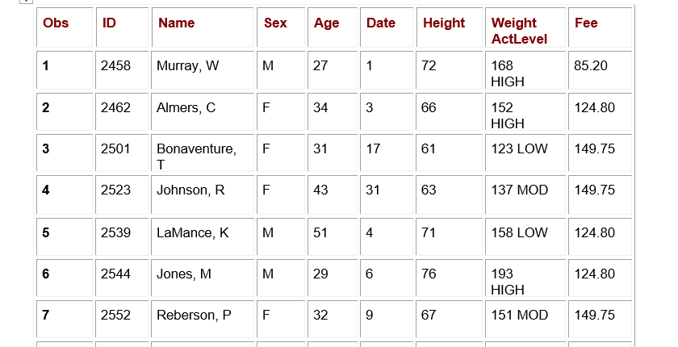
Introduction

Slide 14

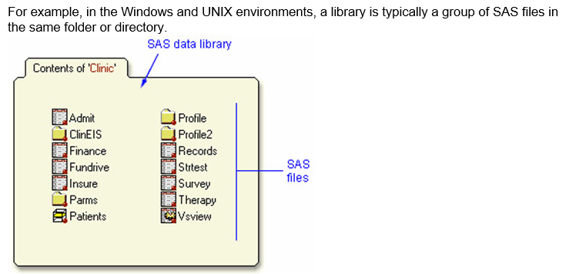
Introduction

Slide 15
SAS Library DEMO

Slide 16
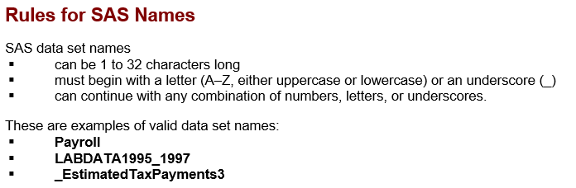
Introduction

Slide 17
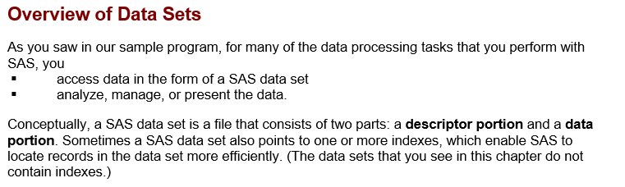
Introduction

Slide 18
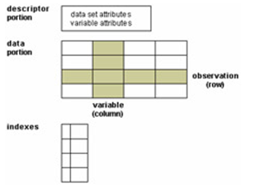
Introduction

Slide 19
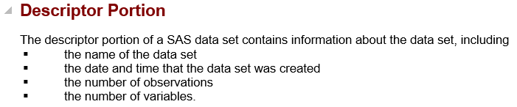
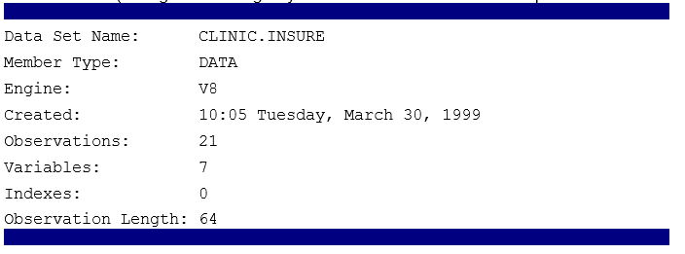
Introduction

Slide 20
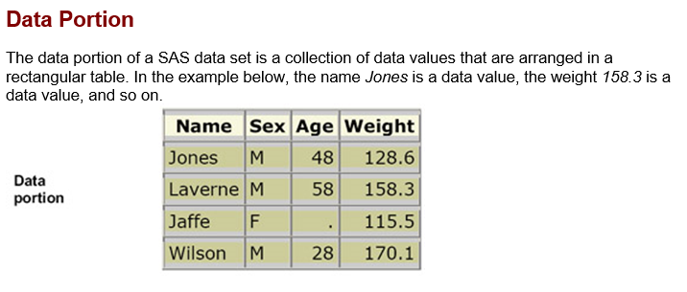
Introduction

Slide 21
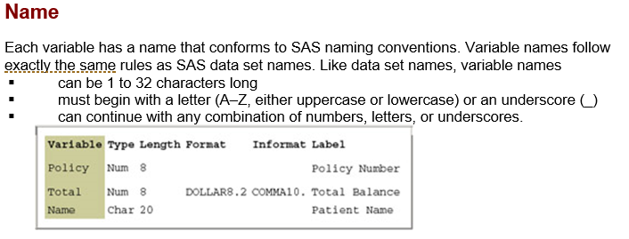
Introduction

Slide 22
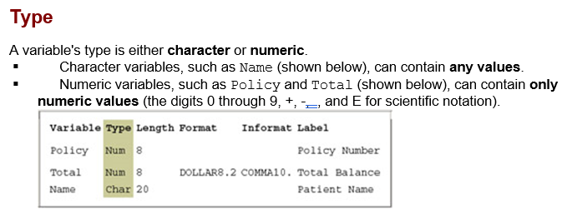
Introduction

Slide 23
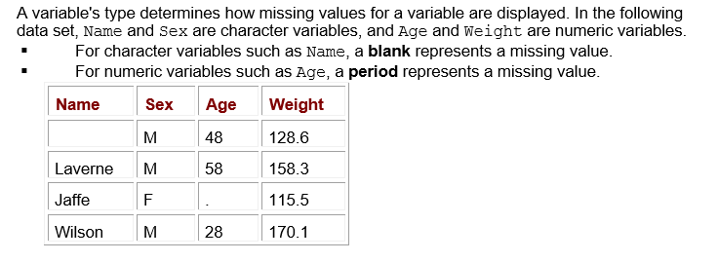
Introduction

Slide 24
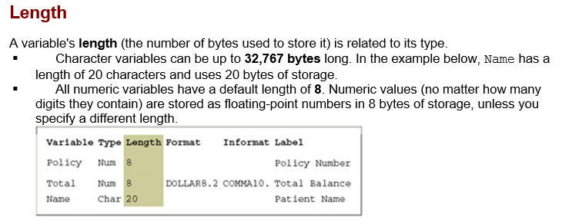
Introduction

Slide 25
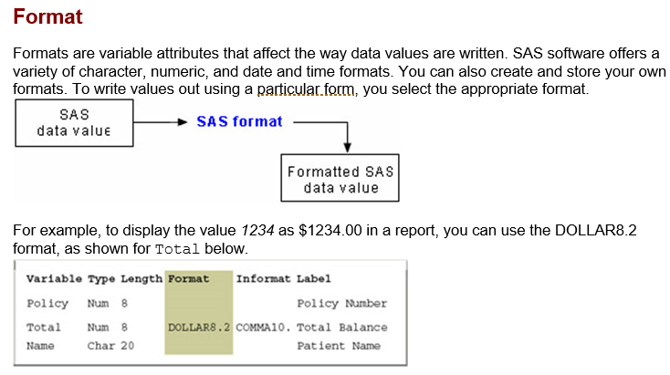
Introduction

Slide 26
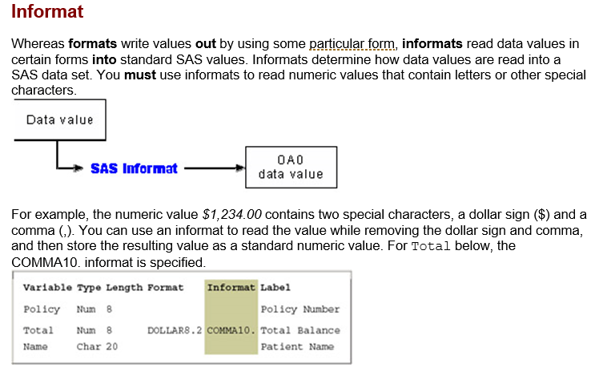
Introduction

Slide 27
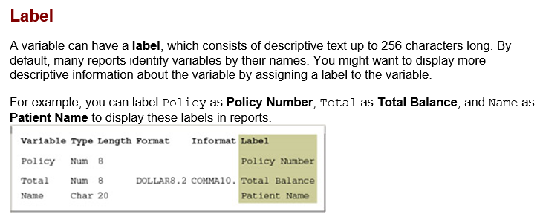
Introduction

Slide 28
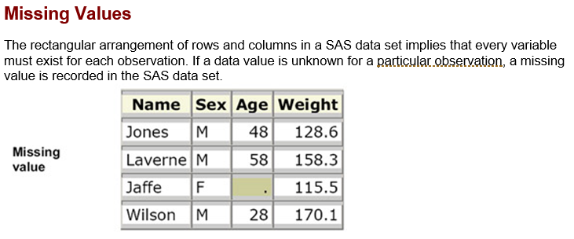
Introduction

Slide 29
Q&A

Slide 30
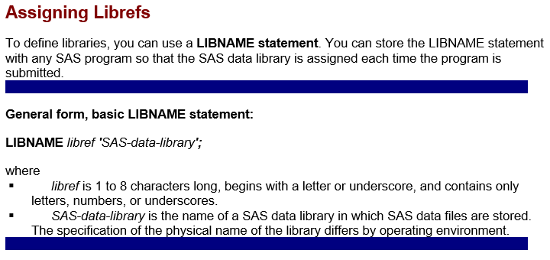
Referencing Files in SAS

Slide 31
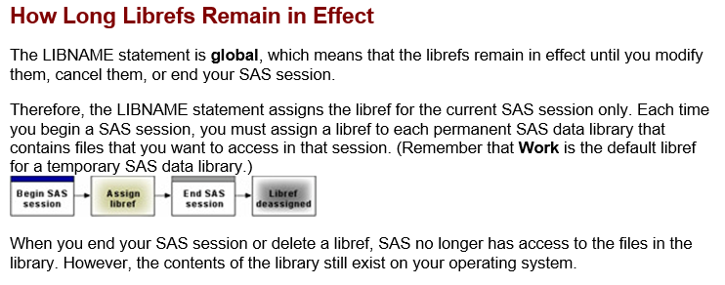
Referencing Files in SAS

Slide 32
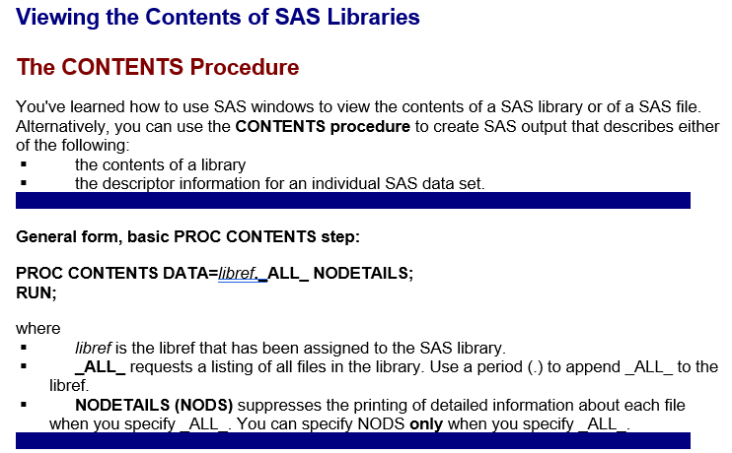
Referencing Files in SAS

Slide 33
PROC CONTENTS
DEMO

Slide 34
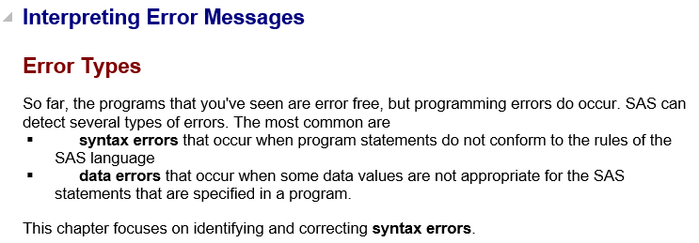
Debugging and Editing SAS Programs

Slide 35
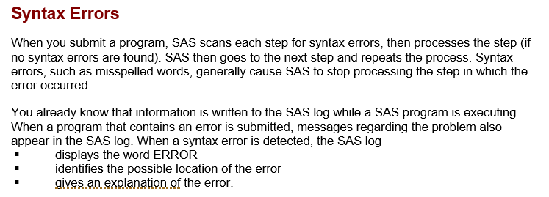
Debugging and Editing SAS Programs

Slide 36
SAS Log DEMO

Slide 37
Debugging and Editing SAS Programs

